Slide 1

Graph and BFS
Submitted By
Khondokar Saim – 221902353
Ashiful Haque Shihab – 221902329
Submitted to
Md. Abu Rumman Refat
Lecturer
Email - refat@cse.green.edu.bd

Slide 2
1
2
TABLE OF CONTENTS
3
4
5
What is GRAPH in Data Structured ?
Graph Terminology
Graph Representation
Applications of Graphs in Data Structure
BFS - Graph Traversal

Slide 3
What is GRAPH in Data
Structured ?
In computer science, a graph is a non-linear data structure that consists of a finite set of vertices (also called nodes) and a set of edges connecting these vertices.
Fig : Directed Graph
There are 2 types of graphs:-
Directed Graph.
Undirected Graph.
Fig : Undirected Graph
Notes:
Chivo

Slide 4
Graph Terminology
There are several key terms and concepts used in the study of graphs in computer science:
Node
Path
Loop
Node
Adjacent Nodes
Directed Edge
Undirected Edge
Multiple Edge
Weight
Loop
Path
Circular Graph
Weight
4
2
3
3
Multiple Edge
Directed Edge
5
5 is adjacent
to 4 node
1
8
Circular
Graph
6
Undirected
Edge
7
Notes:
Chivo

Slide 5
Graph Representation
A
A
B
B
There are several ways to represent a graph in computer memory. Two common ways is to use an
E
E
C
C
D
D
Adjacency Matrix
Adjacency List
A
B
C
D
E
In this representation, the graph can be represented using a matrix of size n x n, where n is the number of vertices.
A
B
C
In this representation, every vertex of the graph contains a list of its adjacent vertices.
A
0
1
1
0
0
B
D
E
If the graph is not dense, i.e., the number of edges is less, then it is efficient to represent the graph through the adjacency list.
B
0
0
0
1
1
This matrix is filled with either 1’s or 0’s.
C
D
Here, 1 represents that there is an edge from row vertex to column vertex, and 0 represents that there is no edge from row vertex to column vertex.
C
0
0
0
1
0
D
A
D
E
D
1
0
0
1
1
E
E
0
0
0
0
0
Fig : Adjacency List
Fig : Adjacency Matrix
Notes:
Chivo

Slide 6
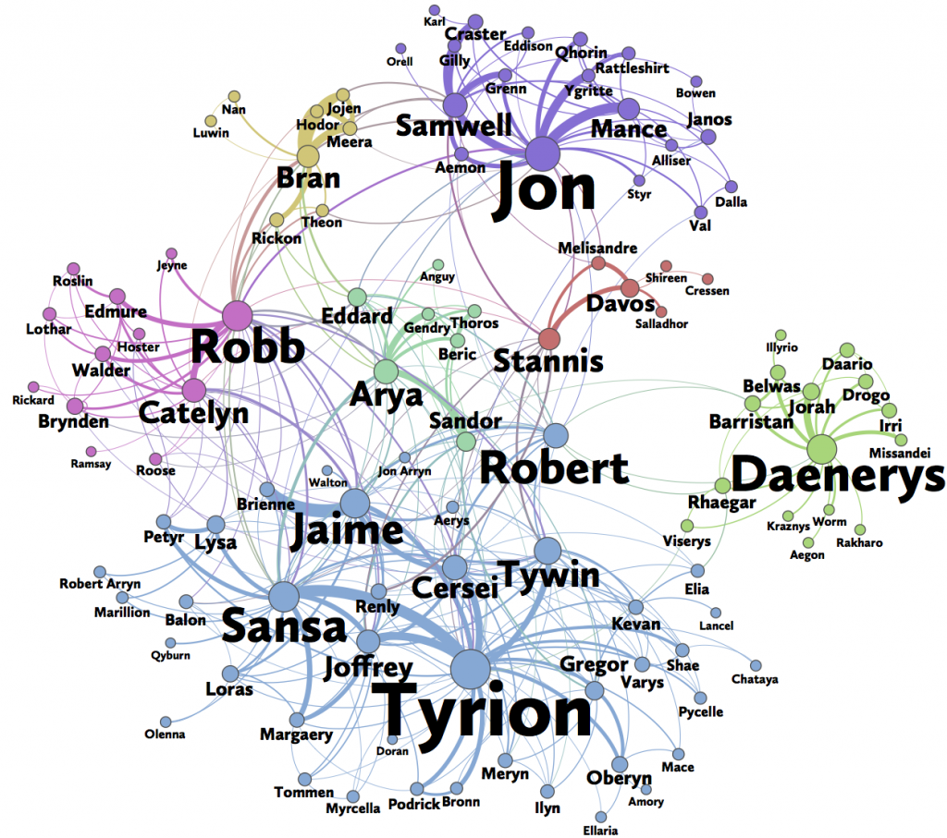
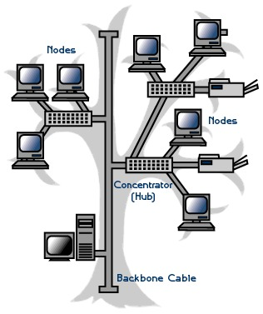
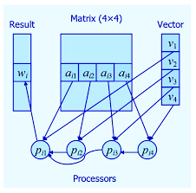
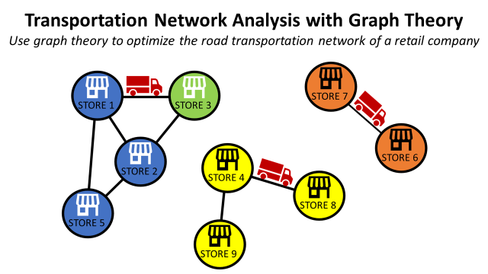
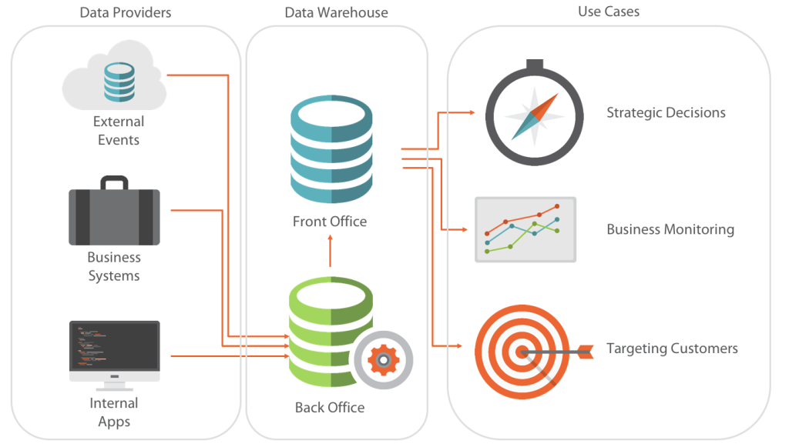
Applications of Graphs in Data Structure
Graphs are a useful data structure for representing and modeling many types of real-world relationships and processes.
Some examples of the application of graphs in real-world and computer science include:
Social networks
Transportation networks
Computer networks
Data organization
Computational processes
Fig : Transportation networks
Fig : Social networks
Fig : Data organization
Fig : Computer networks
Fig : Computational processes
Notes:
Chivo

Slide 7
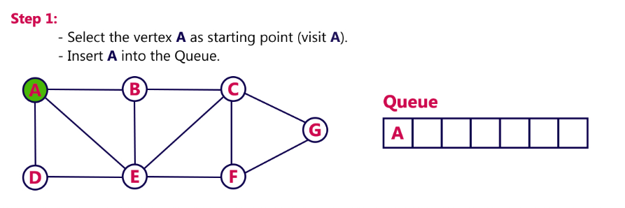
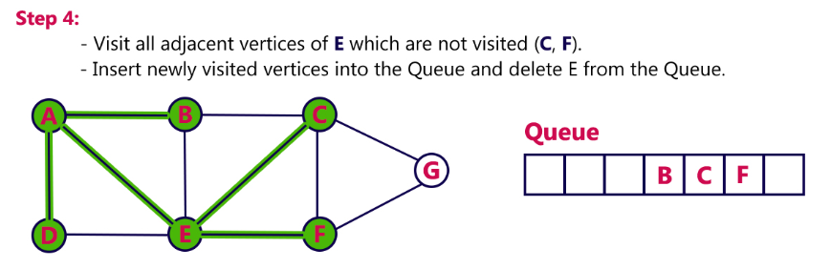
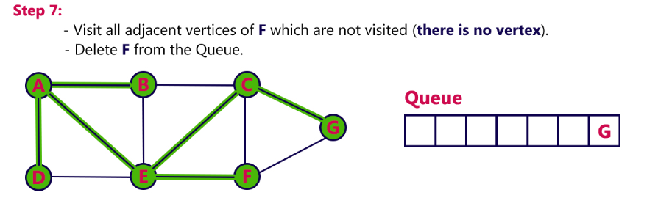
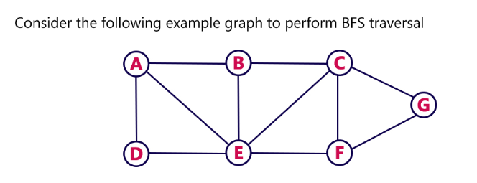
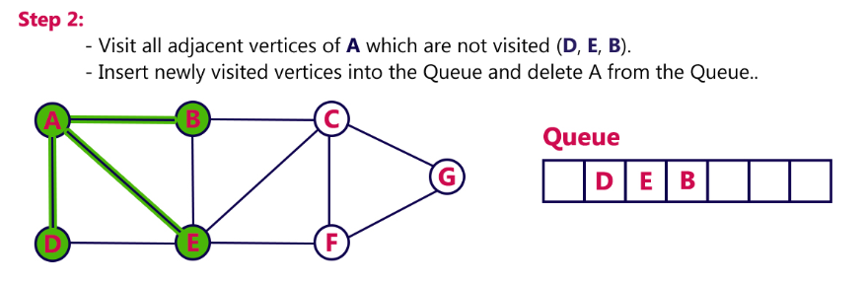
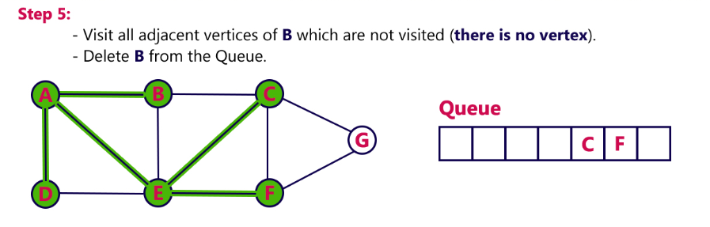
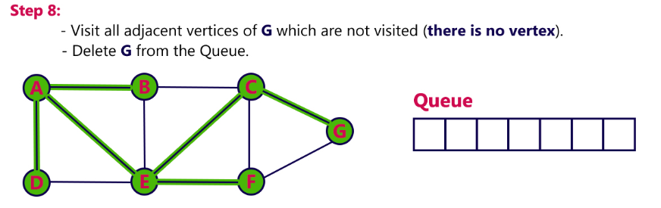
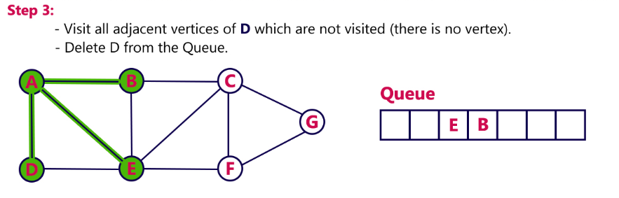
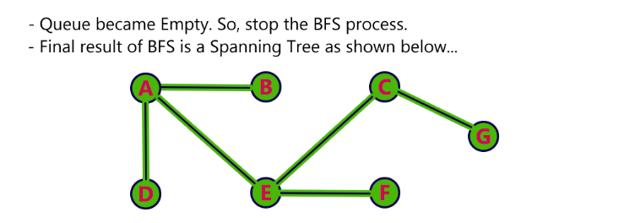
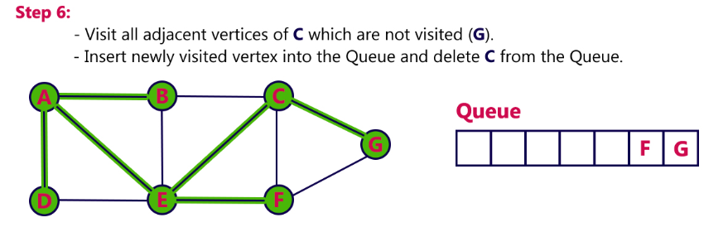
BFS - Graph Traversal
The Graph has two types of traversal algorithms. These are called the -
Breadth First Search (BFS)
Depth First Search (DFS)
Breadth First Search (BFS)
BFS, Breadth-First Search, is a vertex-based technique for finding the shortest path in the graph. It uses a Queue data structure that follows first in first out.
In BFS, one vertex is selected at a time when it is visited and marked then its adjacent are visited and stored in the queue
Notes:
Chivo

Slide 8
Thank You !

